Slide 1

BEGINNERS’ LESSONS
Welcome
Teacher: Your Name Here
Telephone: 123 4567
Email: email@address.co.nz

Slide 2
Lesson Four
Responder’s New Suit Bids

Slide 3
Basic Rules for Responder’s bids
1. Support partner’s suit
2. Bid a new suit
3. Bid NoTrumps if options 1 or 2 are not possible
You have 3 choices

Slide 4
New Suit Bids by Responder
1-level bid = 6+ HCP
2-level bid = 10+ HCP
(Don’t jump to the 2-level if you can bid at the 1-level)
These bids are unlimited
they are FORCING
Opener MUST bid again

Slide 5
Which Suit do you bid first?
1. Longest suit
2. Lower available 4-card suit
3. Higher ranking 5-card suit
These bids are unlimited
they are FORCING
Opener MUST bid again

Slide 6
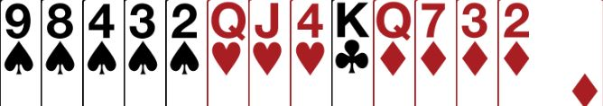
Partner Opens 1♥
What do you bid with this hand ?
6+ points and no fit in hearts
Bid 1♠
your own suit at the 1-level

Slide 7
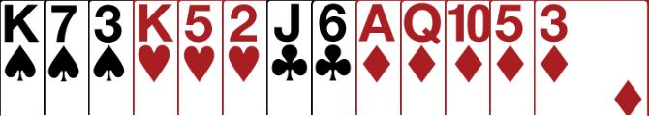
Partner Opens 1♥
What do you bid with this hand ?
10+ points and no fit in hearts
Bid 2♦
your own suit at the 2-level

Slide 8

Partner Opens 1♥
What do you bid with this hand ?
6+ points and no fit in hearts.
Not enough points to bid your longer suit at the 2-level
Bid 1♠
your own suit at the 1-level

Slide 9
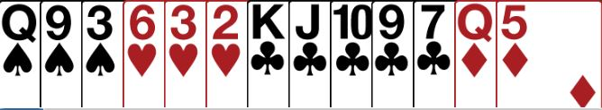
Partner Opens 1♥
What do you bid with this hand ?
6+ points and no fit in hearts.
You cannot bid your own suit at the 1-level or 2-level
You MUST Bid 1NT
the only bid left available to you

Slide 10
Basic Rules for Opener’s Rebid
Agree partner’s suit if you have a fit
Bid NoTrumps if no other option available
Bid another suit (if you can)
Bid your suit again (with extra length)
AT THE SAME TIME
Describe the quality of your hand
  MINIMUM, NEARLY GAME or GAME

Slide 11
What type of Opening hand have you got?
18 – 19 | GAME
16 - 17 | Nearly Game
12 - 15 | Minimum

Slide 12
Supporting Responder’s Suit
MINIMUM (12-15) … raise a level
INVITATIONAL (16-17) … jump a level
GAME (18-19) … bid game
MUST HAVE A FIT
4+ support

Slide 13
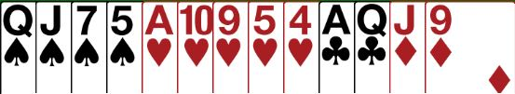
Opener’s Rebid – SUPPORT PARTNER
You open 1♥ with this hand
Partner bids 1♠
You have a fit (14 HCP)
MINIMUM HAND – Bid 2♠

Slide 14

Opener’s Rebid – SUPPORT PARTNER
You open 1♦ with this hand
Partner bids 1♥
You have a fit, 16 HCP
NEARLY GAME (INVITATIONAL) – Bid 3♥

Slide 15

Opener’s Rebid – SUPPORT PARTNER
You open 1♣ with this hand
Partner bids 1♠
You have a fit, 19 HCP
GAME – Bid 4♠

Slide 16
Opener’s NOTRUMP Rebid
LOWEST NT LEVEL = 15 – 17 HCP
JUMP IN NT = 18 – 19 HCP
(forcing to game)
Shows a balanced hand

Slide 17
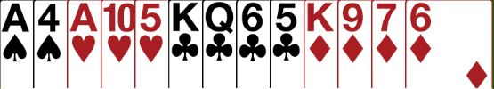
Opener’s NOTRUMP Rebid
You open 1♣ with this hand
Partner bids 1♠
You have a balanced hand with no fit, 16HCP
LOWEST NT LEVEL - Bid 1NT

Slide 18

Opener’s NOTRUMP Rebid
You open 1♦ with this hand
Partner bids 2♣
You have a balanced hand with no fit, 16 HCP
LOWEST NT LEVEL - Bid 2NT

Slide 19

Opener’s NOTRUMP Rebid
You open 1♦ with this hand
Partner bids 1♥
You have a balanced hand with no fit, 18HCP
JUMP IN NT - Bid 2NT

Slide 20
Opener’s NOTRUMP Rebid
You open 1♦ with this hand
Partner bids 2♣
You have a balanced hand with no fit, 18 HCP
JUMP IN NT - Bid 3NT

Slide 21
Opener’s Bid of a New Suit
2nd suit below the barrier = 12 – 15 HCP
2nd suit above the barrier = 16 – 19 HCP
Shows an unbalanced hand
Shows 5+ cards in first suit and
4+ cards in second suit

Slide 22
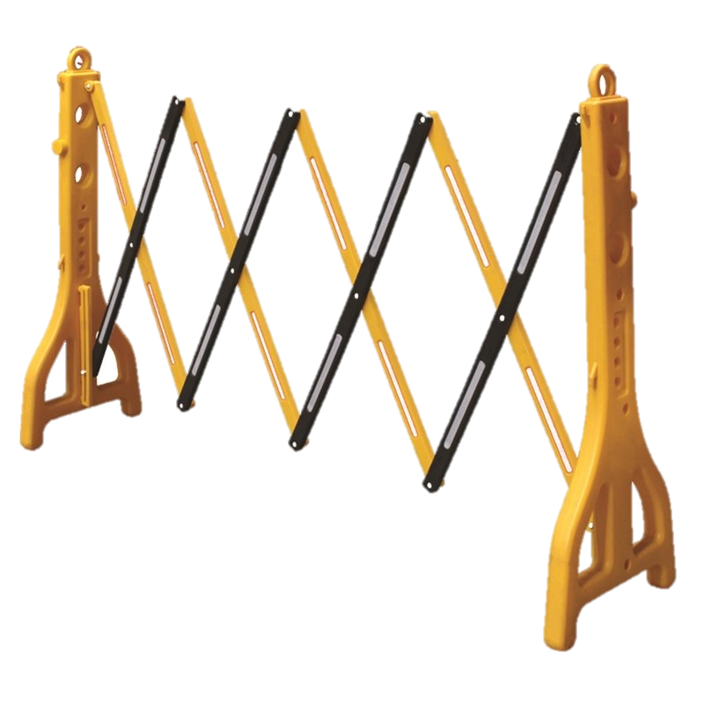
What is the “barrier” ?
Opener DOES NOT bid past their original opening suit unless they have 16+ points

Slide 23
Examples of the “barrier” ?
1♦ | - | 1♠
2♦ is the barrier, so unless you have 16+ points you can only bid 2♣ or 2♦

Slide 24
Examples of the “barrier” ?
1♠ | - | 2♣
What is the barrier in this example ?
What suits can you bid below the barrier ?

Slide 25

Opener’s NEW SUIT Rebid
You open 1♥ with this hand
Partner bids 1♠
No fit with partner, unbalanced, 13 HCP
MINIMUM – bid new suit BELOW 1st suit – Bid 2♣

Slide 26

Opener’s NEW SUIT Rebid
You open 1♦ with this hand
Partner bids 1♠
No fit with partner, unbalanced, 12 HCP
MINIMUM – CANNOT BID HEARTS
Rebid 1st suit – Bid 2♦

Slide 27

Opener’s NEW SUIT Rebid
You open 1♥ with this hand
Partner bids 1♠
No fit with partner, unbalanced, 19 HCP
GAME – MUST BID PAST THE BARRIER
Jump in second suit – Bid 3♦

Slide 28
Opener’s Rebid of their Own Suit
2-level = 12-15 HCP
Jump = 16-17HCP (6+)
GAME = 18-19 HCP (6+)
Usually shows a single
suited hand

Slide 29

Opener’s Rebid of their Own Suit
You open 1♦ with this hand
Partner bids 1♠
No fit with partner, unbalanced, 12 HCP
MINIMUM
Rebid your own suit – Bid 2♦

Slide 30

Opener’s Rebid of their Own Suit
You open 1♥ with this hand
Partner bids 1♠
No fit with partner, unbalanced, 16 HCP
NEARLY GAME (INVITATIONAL)
Rebid your own suit – Bid 3♥

Slide 31

Opener’s Rebid of their Own Suit
You open 1♠ with this hand
Partner bids 2♣
No fit with partner, unbalanced, 17 HCP
GAME 6+ own suit and partner has 10+ HCP
Bid GAME in your suit – Bid 4♠

Slide 32
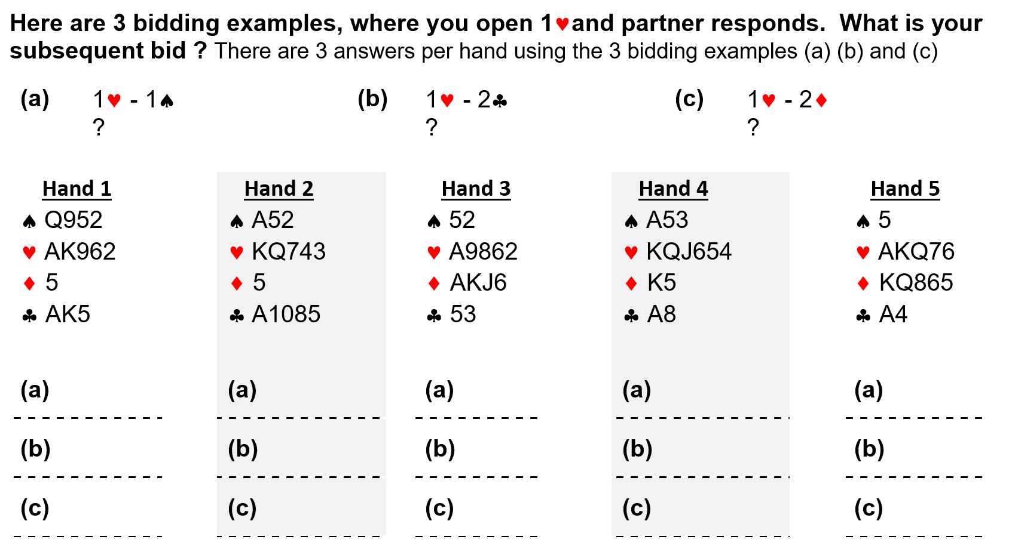
How to answer the quiz

Slide 33
How to answer the quiz

Slide 34
How to answer the quiz
Repeat hands 2 to 5 in the same manner

Slide 35
BEGINNERS’ LESSONS
Any Question Please Contact
Teacher: your name
Telephone: your number
Email: your email

