Slide 1

BEGINNERS’ LESSONS
Welcome
Teacher: Your Name Here
Telephone: 123 4567
Email: email@address.co.nz

Slide 2
Lesson Three
Responder’s Limit Bids

Slide 3

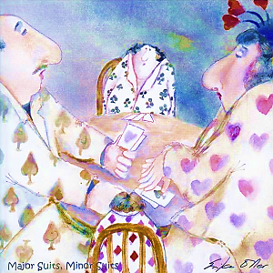
Ranking of the Suits
NoTrumps
Spades ♠
Hearts ♥
Diamonds ♦
Clubs ♣
Major suits
Minor suits
Notes:
Emphasise Major / NoTrumps / Minor ... Talk about this as often as possible

Slide 4
Finding a Fit
A Fit is 8+ cards in one suit between the two hands
If there is a fit in a major suit, then this will be the trump suit
If there is no fit, then choose NoTrumps

Slide 5

Basic Rules for Opening bids
You must have enough High Card Points
12+

Slide 6
Basic Rules for Responder’s bids
You must have enough High Card Points
6+

Slide 7
Basic Rules for Responder’s bids
1. Support partner’s suit
2. Bid a new suit (next week’s lesson)
3. Bid NoTrumps … the bid when you have no other choice
You have 3 choices

Slide 8
Responder’s Limit bids
Support partner’s suit
Bid NoTrumps … the bid when you have no other choice
These are limit bids
… they are NOT FORCING

Slide 9
FIRST CHOICE: Support Partner’s suit
Minimum (6-9) … bid at the 2-level
Nearly game (10-12) … bid at the 3-level
Game (13+) … bid at the Game level
These are limit bids
… they are NOT FORCING

Slide 10
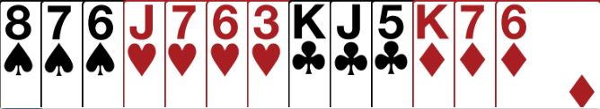
Partner Opens 1♥ … what do you bid?
6 - 9 points … with a fit
Bid 2 ♥ … MINIMUM

Slide 11
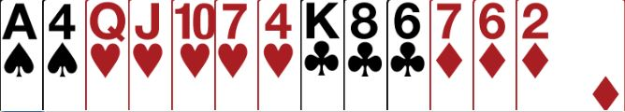
Partner Opens 1♥ … what do you bid?
10 – 12 points … with a fit
Bid 3♥ … CLOSE TO GAME

Slide 12
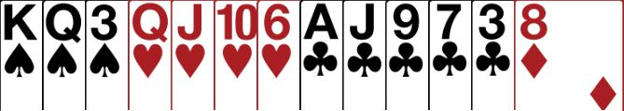
Partner Opens 1♥ … what do you bid?
13+ points … with a fit
Bid 4♥ … GAME

Slide 13
Can’t bid a suit ? Bid NoTrumps
Minimum (6-9) … bid 1NT
Nearly game (10-12) … bid 2NT
Game (13-15) … bid 3NT
These are limit bids …
they are NOT FORCING

Slide 14
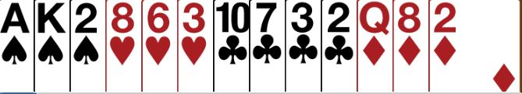
Partner Opens 1♥ … what do you bid?
No fit in hearts
with 6-9 points …. MUST bid 1NT

Slide 15
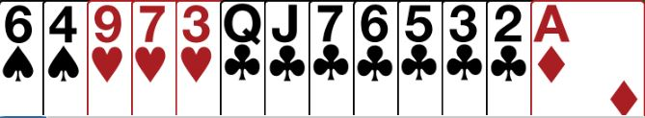
Partner Opens 1♥ … what do you bid?
No fit in hearts
with 6-9 points …. MUST bid 1NT

Slide 16


Partner Opens 1♥ … what do you bid?
No fit in hearts
with 10-12 points …. MUST bid 2NT

Slide 17
Opener’s REBID after 2-level (6-9) raise
OPENER | HCP | ACTION
Minimum | 12 – 15 | PASS
Close to Game | 16 – 17 | INVITE (bid 3)
GAME | 18 – 19 | BID GAME

Slide 18
Opener’s REBID after 3-level raise
OPENER | HCP | ACTION
Minimum | 12 – 13 | PASS
GAME | 14+ | BID GAME

Slide 19
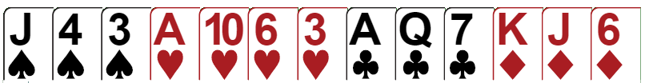
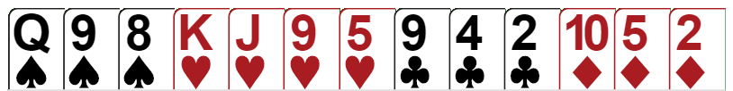
Opening – Responding - rebidding
Opener
Opener’s rebid:
Open:
1♥
PASS
Responder
Respond:
2♥

Slide 20


Opening – Responding - rebidding
18HCP
Opener
3♥
Open:
1♥
Opener’s rebid:
Responder
6
HCP
Respond:
2♥

Slide 21

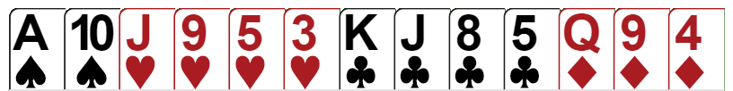
Opening – Responding - rebidding
15HCP
Opener
Open:
1♥
Opener’s rebid:
4♥
Responder
11
HCP
Respond:
3♥

Slide 22
Opener’s REBID after 1NT response (6-9)
OPENER | HCP | ACTION
Minimum | 12 – 15 | Pass Bid lower new suit Rebid own suit
Close to Game | 16 – 17 | Bid new suit Bid 2NT Jump in own suit (6+)
GAME | 18 – 19 | BID GAME Bid 3NT Bid 4 Major (6+)

Slide 23
Opener’s REBID after 2NT response (10-12)
OPENER | HCP | ACTION
Minimum | 12 – 13 | Pass Rebid own suit (6+)
GAME | 14 + | Bid new suit Bid 3NT Bid 4 Major (6+)

Slide 24
BEGINNERS’ LESSONS
any questions please ask
Teacher: your name
Telephone: your number
Email: your email

