Slide 1

BEGINNERS’ LESSONS
Welcome
Teacher: Your Name Here
Telephone: 123 4567
Email: email@address.co.nz

Slide 2
Lesson One
Introduction to Bridge

Slide 3
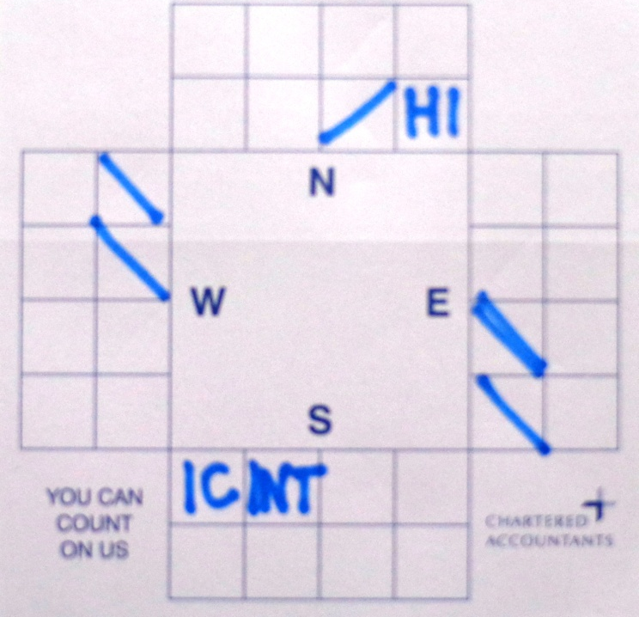
Lesson One – Introduction to Bridge
The Game of bridge is played in 2 distinct phases:
PHASE 1
The Auction … each person in the partnership ‘talks’ to each other to describe what they have in their hand to work out the best contract
Notes:
Demonstrate playing of cards … get them to play one board … no interference

Slide 4
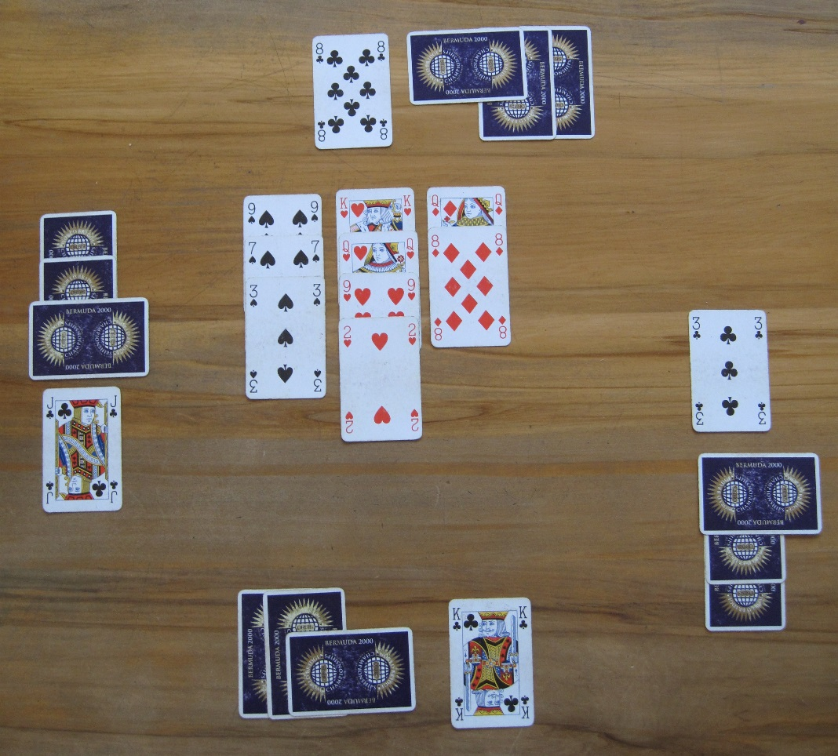
Lesson One – Introduction to Bridge
PHASE 2
The Play … the winning partnership now needs to fulfil their contract
Notes:
Demonstrate playing of cards … get them to play one board … no interference

Slide 5

PHASE 1 - The Auction
The process of ‘talking’ to each other to describe the contents of your hand
The Dealer is the first person to bid
Bids must be made in the correct order
Bids are made clockwise
If you have nothing to say …
you can PASS !

Slide 6

PHASE 1 – The Auction
Bidding is written down
The auction concludes when there have been 3 passes in
a row
The Contract is the last bid made before those 3 passes
The player who bids the suit first will be the Declarer

Slide 7
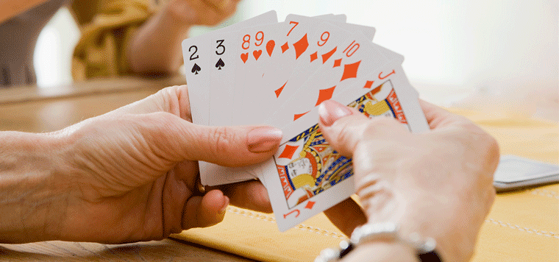
PHASE 2 – The Play of the Hand
The Declarer is the person who plays the hand
The opening lead is made by the person on Declarer’s left
Dummy lays their cards out on the table with the trump suit on their right
The cards laid on the table are also known as the Dummy

Slide 8
PHASE 2 - Play of the Hand
Declarer plays their own cards AND calls for Dummy’s cards
A trick is a collection of 4 cards – one from each player
A player must follow suit where possible
The highest card of the suit led wins the trick UNLESS a trump is played
If you win the trick, you lead to the next trick

Slide 9
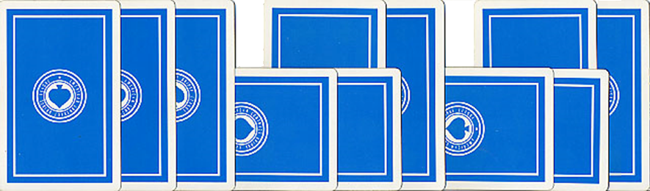
How the Cards are Placed
Each player keeps their own cards in front of them
If you win the trick the card is placed vertically in front of you
If you lose the trick the card is placed horizontally in front of you

Slide 10
Ranking of Cards in a Suit
Cards are ranked from highest to lowest
A K Q J 10 9 8 7 6 5 4 3 2

Slide 11

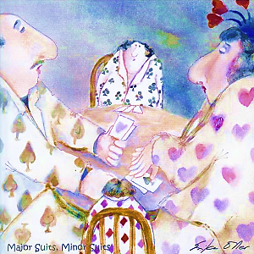
Ranking of the Suits
NoTrumps
Spades ♠
Hearts ♥
Diamonds ♦
Clubs ♣
Major suits
Minor suits
Notes:
Emphasise Major / NoTrumps / Minor ... Talk about this as often as possible

Slide 12
How bidding works
1♣ | 1♦ | 1♥ | 1♠ | 1NT
2♣ | 2♦ | 2♥ | 2♠ | 2NT
3♣ | 3♦ | 3♥ | 3♠ | 3NT
4♣ | 4♦ | 4♥ | 4♠ | 4NT
5♣ | 5♦ | 5♥ | 5♠ | 5NT
6♣ | 6♦ | 6♥ | 6♠ | 6NT
7♣ | 7♦ | 7♥ | 7♠ | 7NT
The 1-level bid means you plan to win 6+1 tricks, ie 7
2-level 6 + 2 (8 tricks), 3-level 6 + 3 (9 tricks), etc

Slide 13
How bidding works
1♣ | 1♦ | 1♥ | 1♠ | 1NT
2♣ | 2♦ | 2♥ | 2♠ | 2NT
3♣ | 3♦ | 3♥ | 3♠ | 3NT
4♣ | 4♦ | 4♥ | 4♠ | 4NT
5♣ | 5♦ | 5♥ | 5♠ | 5NT
6♣ | 6♦ | 6♥ | 6♠ | 6NT
7♣ | 7♦ | 7♥ | 7♠ | 7NT
If bidding, your bid cannot be a lower ranked suit at the same level as the previous bid.

Slide 14
How bidding works
1♣ | 1♦ | 1♥ | 1♠ | 1NT
2♣ | 2♦ | 2♥ | 2♠ | 2NT
3♣ | 3♦ | 3♥ | 3♠ | 3NT
4♣ | 4♦ | 4♥ | 4♠ | 4NT
5♣ | 5♦ | 5♥ | 5♠ | 5NT
6♣ | 6♦ | 6♥ | 6♠ | 6NT
7♣ | 7♦ | 7♥ | 7♠ | 7NT
EXAMPLE
if someone bids 1♦ the next person CANNOT bid 1♣
If they want to bid clubs, they would have to bid 2 ♣

Slide 15
How bidding works
1♣ | 1♦ | 1♥ | 1♠ | 1NT
2♣ | 2♦ | 2♥ | 2♠ | 2NT
3♣ | 3♦ | 3♥ | 3♠ | 3NT
4♣ | 4♦ | 4♥ | 4♠ | 4NT
5♣ | 5♦ | 5♥ | 5♠ | 5NT
6♣ | 6♦ | 6♥ | 6♠ | 6NT
7♣ | 7♦ | 7♥ | 7♠ | 7NT
Game scores are worth a lot more !
NoTrumps is at the 3-level, Majors at the 4-level and
minors at the 5-level

Slide 16
How bidding works
1♣ | 1♦ | 1♥ | 1♠ | 1NT
2♣ | 2♦ | 2♥ | 2♠ | 2NT
3♣ | 3♦ | 3♥ | 3♠ | 3NT
4♣ | 4♦ | 4♥ | 4♠ | 4NT
5♣ | 5♦ | 5♥ | 5♠ | 5NT
6♣ | 6♦ | 6♥ | 6♠ | 6NT
7♣ | 7♦ | 7♥ | 7♠ | 7NT
Slam scores are better still !
Slam
Grand Slam

Slide 17
The contract Suit ♣ ♦ ♥ ♠
Naming a suit as the contract means the suit is to be trumps
Trumps is the dominant suit
A card from the trump suit is more powerful than any other card
NoTrumps means that there is no dominant suit

Slide 18
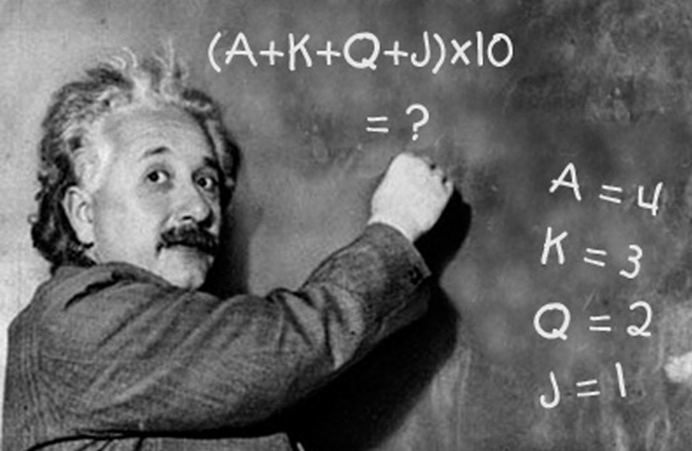
Value of the Honour Cards
Add your High Card Points (HCP) together
  Ace A = 4 points
  King K = 3 points
  Queen Q = 2 points
  Jack J = 1 point
  Each suit total = points Each deal total = points
10
40

Slide 19
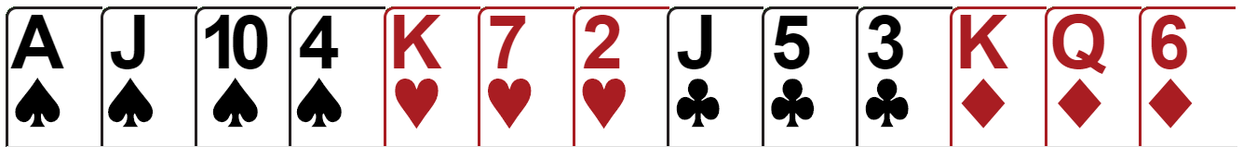
How many High Card Points?
4
1
3
1
3
2
14

Slide 20
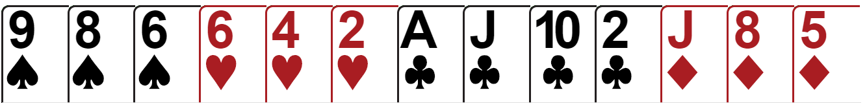
How many High Card Points?
6

Slide 21
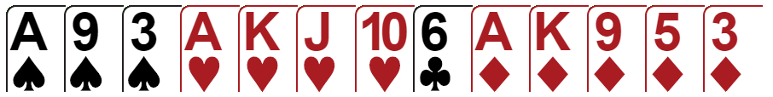
How many High Card Points?
19

Slide 22
Finding a Fit
A Fit is 8+ cards in one suit between the two hands
If there is a fit in a major suit, then this will be the trump suit
If there is no fit, then choose NoTrumps

Slide 23
Finding a Fit
If there is a fit in a minor, then you can choose whether to play in the minor or in NoTrumps
The quality of the cards does not matter … there just have to be 8 or more of them in the suit

Slide 24
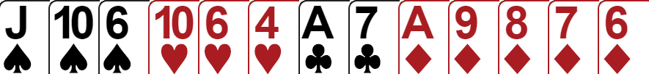
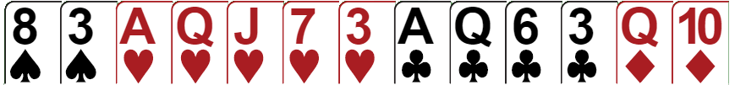
Which suit has a fit? 8+ cards between the two hands
K

Slide 25
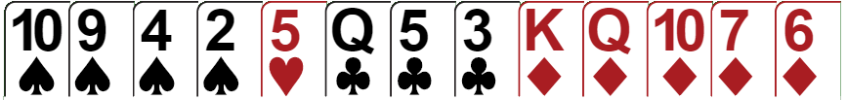
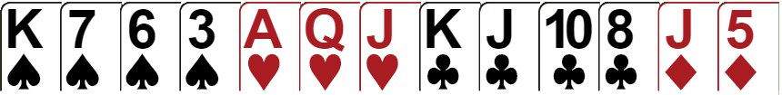
Which suit has a fit? 8+ cards between the two hands

Slide 26
What is the Partnership looking for?
STEP ONE: Find a fit
or more cards in the same suit
between both hands

Slide 27

The Rules of Mini-Bridge (Boards 1 - 4)
Write down your High Card Points on the bidding pad … Dealer goes first, then clockwise
The partnership with the most points between them becomes the declaring side
Within that side, the person with the most points becomes declarer
Opening lead comes from player on declarer’s left (I will tell you what card to lead)
Dummy is placed on the table face up
Declarer chooses trumps (or NoTrumps)
Notes:
On Board One ... Take them through the process one step at a time, then let them loose on boards 2 – 4, leave this on screen during that time. WRITE UP THE OPENING LEADS FOR EACH BOARD

Slide 28

What is the Partnership looking for?
STEP ONE: Find a fit
STEP TWO: Decide the level to play the contract
Partscore | Total Points | 25
Game | Total Points | 25 – 32
Slam | Total Points | 33+
Less than

Slide 29
What is GAME?
You get a large bonus for bidding and making a GAME contract
The number of tricks required to make game depends on the trump suit or NoTrumps
3NT | - | 9 tricks
4♥/♠ | - | 10 tricks
5♣/♦ | - | 11 tricks

Slide 30
GAME Contracts
1♣ | 1♦ | 1♥ | 1♠ | 1NT
2♣ | 2♦ | 2♥ | 2♠ | 2NT
3♣ | 3♦ | 3♥ | 3♠ | 3NT
4♣ | 4♦ | 4♥ | 4♠ | 4NT
5♣ | 5♦ | 5♥ | 5♠ | 5NT
6♣ | 6♦ | 6♥ | 6♠ | 6NT
7♣ | 7♦ | 7♥ | 7♠ | 7NT
Notes:
Emphasise the importance of getting to GAME where possible

Slide 31
The Rules of Mini-Bridge (Boards 5 - 8)
Write down your High Card Points on the bidding pad … Dealer goes first
The partnership with the most points between them becomes the declaring side
Within that side, the person with the most points becomes declarer
Opening lead comes from player on declarer’s left (I will tell you what card to lead)
Dummy is tabled
Declarer chooses trumps (or NoTrumps)
Declarer then chooses the level they want to play (partscore or game)

Slide 32
What is the Partnership looking for?
STEP ONE: Find a fit
STEP TWO: Decide the level to play the contract
Partscore | Total Points | 25
Game | Total Points | 25 – 32
Slam | Total Points | 33+
Less than

Slide 33
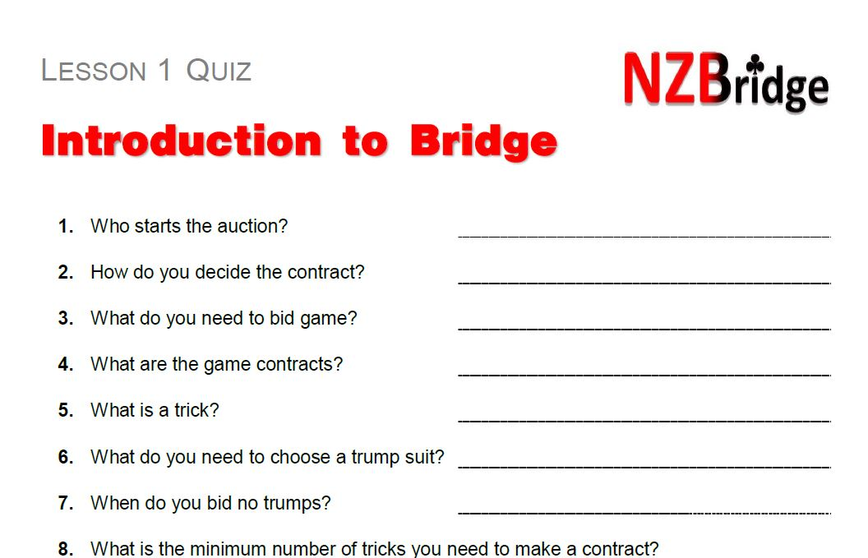
Homework (sorry)

Slide 34

Practice and Review
Review tonight’s lesson notes as soon as possible
Review lesson notes again before next week’s lesson
Do your homework – Quiz 1
….. Please

Slide 35
BEGINNERS’ LESSONS
Welcome
Teacher: your name
Telephone: your number
Email: your email

