Slide 1

BEGINNERS’ LESSONS
Welcome
Teacher: Your Name Here
Telephone: 123 4567
Email: email@address.co.nz

Slide 2
Tip
Opening Leads

Slide 3
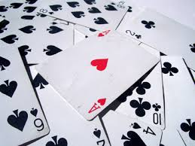
TWO TYPES OF CONTRACT
Suit Contracts
OR
NoTrump Contracts

Slide 4
Leads against a Suit Contract
DO!
Lead partner’s suit (if they have bid one)
Lead TOP of a sequence
Lead a singleton in a side suit
Lead your lowest card if you have an honour
Lead top of rubbish cards

Slide 5
Leads against a NoTrump Contract
DO
Lead partner’s suit (if they have bid one)
Lead from your longest suit
Lead TOP of a sequence
Lead your lowest card from an honour
Prefer a major over a minor
Lead top of rubbish cards

Slide 6
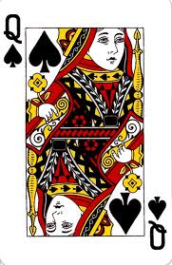
What would this lead by partner mean?
Top of a sequence
Partner has the Jack (and hopefully the 10 as well)
Partner does NOT have the King

Slide 7
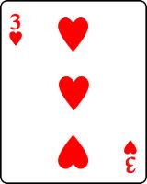
What would this lead by partner mean?
Low from an honour
Partner has a King, Queen or Jack of hearts
Partner has at least 3 hearts
NOTE: If defending against No Trumps, partner may also have the Ace of the suit led
If leading against a suit contract … partner MAY have a singleton heart

Slide 8
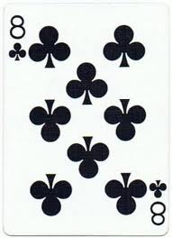
What would this lead by partner mean?
Top of Rubbish
Partner has no honour cards in clubs
If leading against a suit contract … partner MAY have a singleton club

Slide 9

Leads against a Suit Contract
DO NOT
DO NOT lead away from an Ace … NEVER EVER EVER!!!
DO NOT lead away from broken honour suits eg K J 9 2
DO NOT lead singleton honour cards
TRY NOT to lead suits bid by the opposition
DO NOT lead a suit with an Ace in it
Unless partner has bid that suit
Or you lead the Ace (in which case, you have at least Ace AND King in the suit)

Slide 10
BEGINNERS’ LESSONS
Please contact me if you have any questions
Teacher: Your Name Here
Telephone: 123 4567
Email: email@address.co.nz

