Slide 1

BEGINNERS’ LESSONS
Welcome
Teacher: Your Name Here
Telephone: 123 4567
Email: email@address.co.nz

Slide 2
Lesson Eight
Takeout Doubles

Slide 3
Reasons for Overcalling
To get into the bidding … make it hard for the opposition
Express a genuine desire to play in a suit
Suggest a lead for partner

Slide 4

Rules to Overcall a suit
MUST be a 5+ card suit with a good suit – 2+ honours in suit
Point count should be close to opening values … a little
bit less is OK though

Slide 5
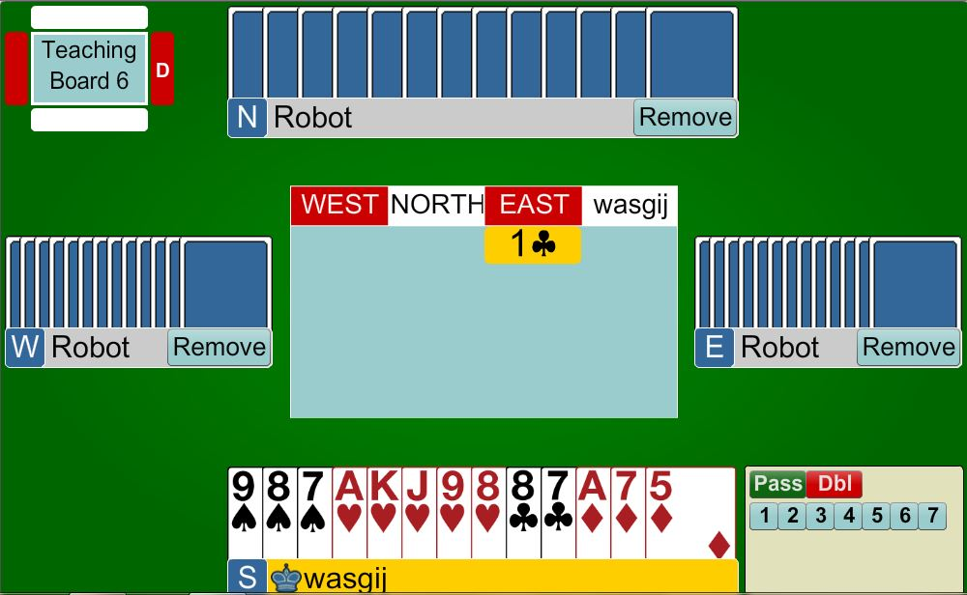

Overcalling a suit
PARTNER
1♥
South has an Opening Hand with a GOOD 5-card suit
(at least two honours in the suit)
HIM
HER
YOU

Slide 6
Rules to Overcall in NoTrumps
You need BETTER points than an opening 1NT
  16 – 18 points
MUST have a cover in the
opposition’s suit

Slide 7
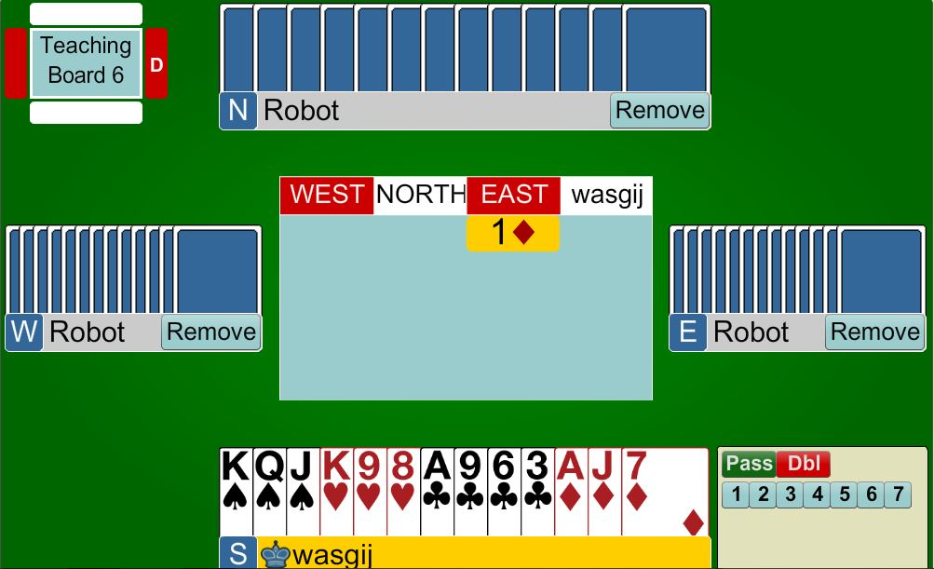
Overcalling
1NT
PARTNER
1NT
18 points
balanced hand with a diamond hold
HIM
HER
YOU

Slide 8

WHAT HAPPENS when your hand doesn’t meet this criteria?
No 5-card major
Can’t overcall NT because you have no hold in the opposition’s suit
Can’t overcall NT because your
hand is not strong enough

Slide 9
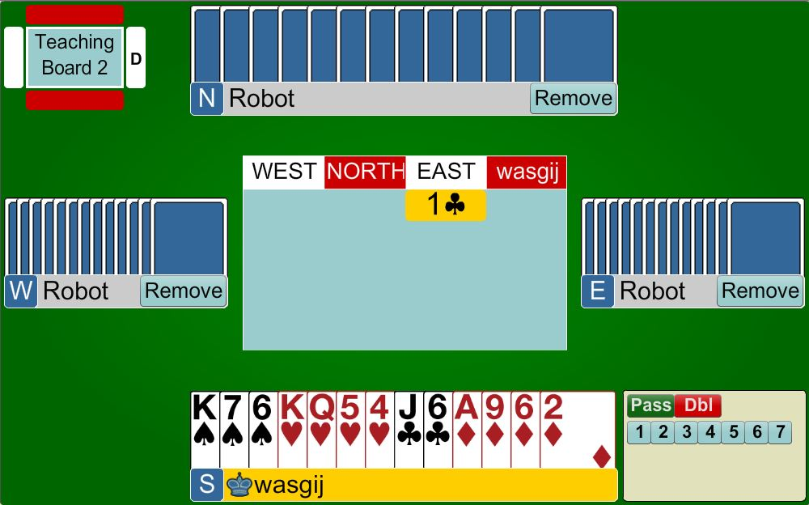

Takeout Double
PARTNER
X
13 points, no 5-card major
- can’t bid a suit
- can’t bid 1NT
(not strong enough)
HIM
HER
YOU

Slide 10
Takeout Double shows the following:
At least 3 cards in each of the unbid suits
Shortage in the opponent’s suit
Opening hand (12+ points)
asks partner to choose the best contract
DO NOT double with 4+ of the opponent’s suit

Slide 11
Choices when Overcalling
FIRST CHOICE - Overcall a major
SECOND CHOICE - Overcall 1NT
THIRD CHOICE - Use the takeout X
FOURTH CHOICE- Overcall a minor
REMEMBER MAJORS ARE MORE IMPORTANT THAN THE MINORS OR NT

Slide 12
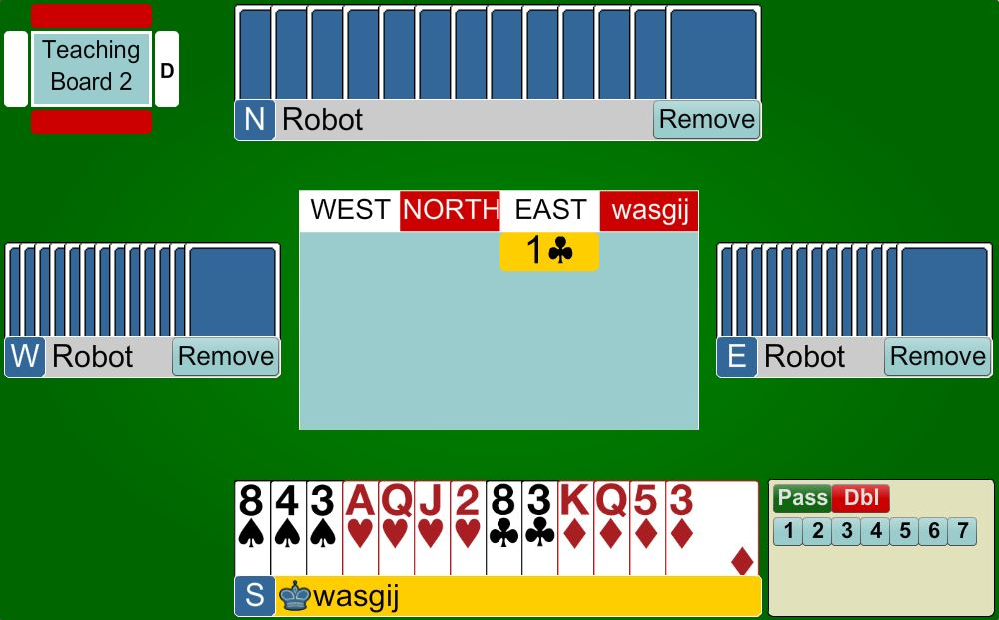
Takeout Double
PARTNER
X
12+ points
3+ cards in each of
the unbid suits
Shortage in opposition suit
HIM
HER
YOU

Slide 13
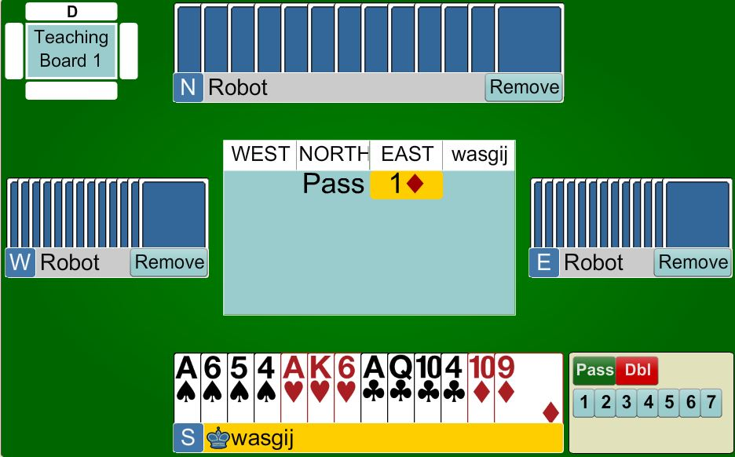

Takeout Double
PARTNER
X
12+ points
3+ cards in each of
the unbid suits
Shortage in opposition suit
HIM
HER
YOU

Slide 14
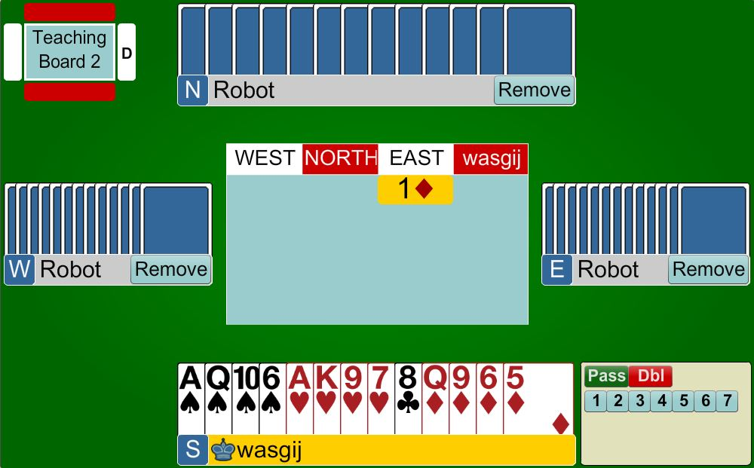
Takeout Double
PARTNER
1♣
X
12+ points
3+ cards in each of
the unbid suits
Shortage in opposition suit
HIM
HER
YOU

Slide 15
Takeout Double
PARTNER
PASS
15 points
BUT only 1 club and not balanced so must PASS
HIM
HER
YOU

Slide 16
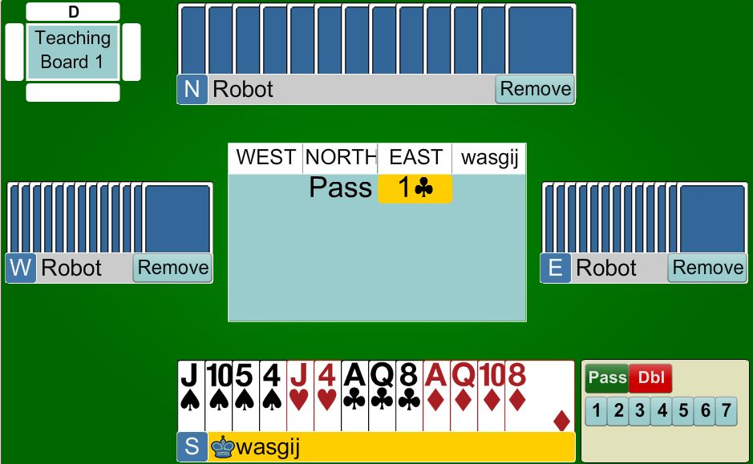
Takeout Double
PARTNER
PASS
14 points
BUT only 2 hearts. A balanced hand but cannot bid 1NT because there are not enough points so must PASS
HIM
HER
YOU

Slide 17

Response to a Takeout Double
If your Right Hand Opponent passes - YOU MUST BID
  even if you have no points !
  even at the 2-level if necessary
  REMEMBER: partner has promised that they can handle any other suit
You do not have to bid after an opponent calls

Slide 18
Response to a Takeout Double
FIRST CHOICE
  Give preference to a major
SECOND CHOICE
  Bid 1NT
THIRD CHOICE
  Give preference to a minor
You do not have to bid after an opponent calls

Slide 19
Response to a Takeout Double
GAME | 13+ | Jump to GAME Suit (5+), or 3NT
INVITATIONAL | 10-12 | Jump in a suit (4+) Bid 2NT (with a stop)
MINIMUM | 0-9 | Bid your own suit (4+) Or 1NT with 6-9 points

Slide 20

Response to a Takeout Double
If the opponent’s bid BEFORE you are forced to bid, you can now PASS
Therefore a bid from you now
shows 8+ points … it is a CONSTRUCTIVE bid
You do not have to bid after an opponent calls

Slide 21
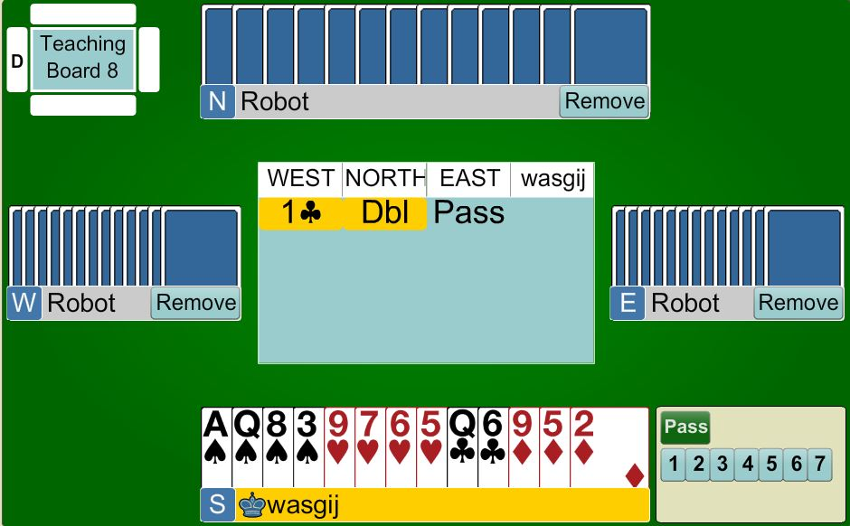
Response to the Takeout Double
PARTNER
1♥
Bid your lowest
4 -card major
With less than 10 points, bid at the lowest level possible
HIM
HER
YOU

Slide 22
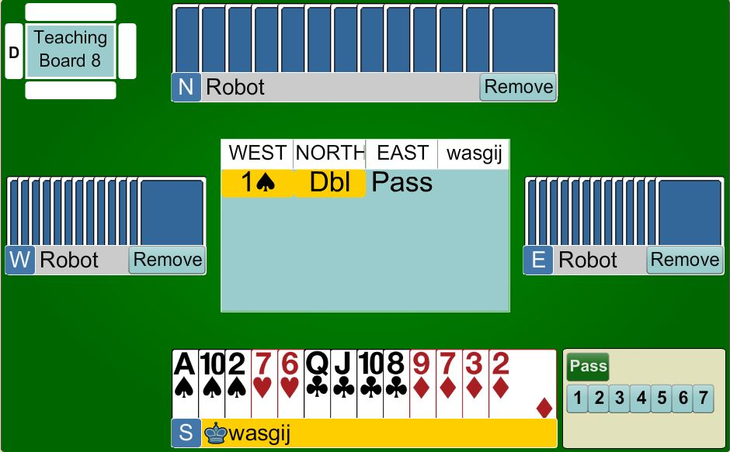
Response to the Takeout Double
PARTNER
1NT
6 – 9 points
no 4-card major, balanced with with a Spade hold
… therefore bid 1NT
HIM
HER
YOU

Slide 23
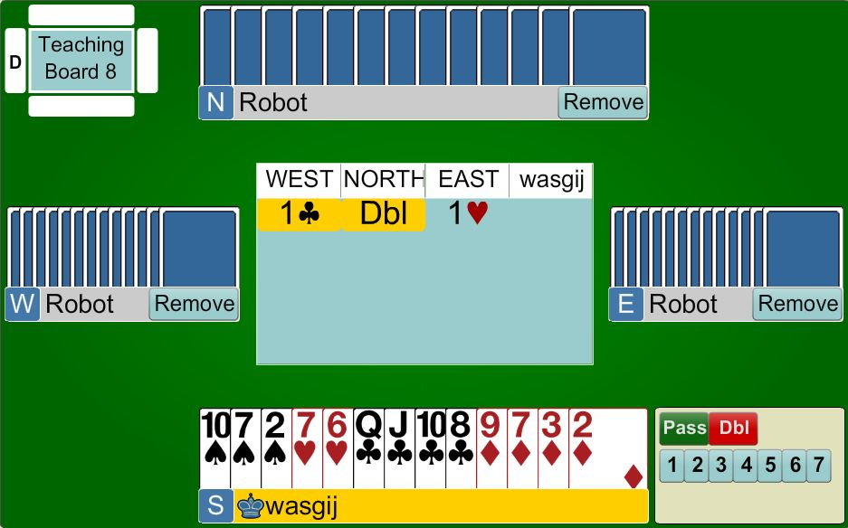
Response to the Takeout Double
PARTNER
PASS
East has bid so you now don’t have to bid
With less than 8 points - PASS
HIM
HER
YOU

Slide 24

Response to the Takeout Double
PARTNER
1♥
Bid your major at the lowest level
HIM
HER
YOU

Slide 25
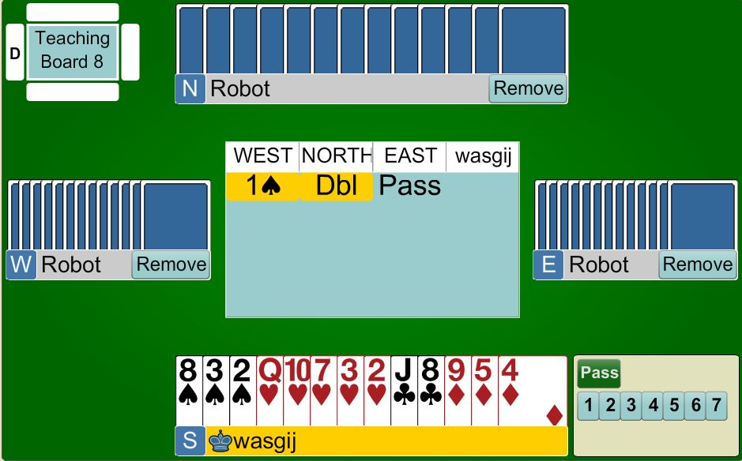
Response to the Takeout Double
PARTNER
2♥
Bid your major at the lowest level
HIM
HER
YOU

Slide 26
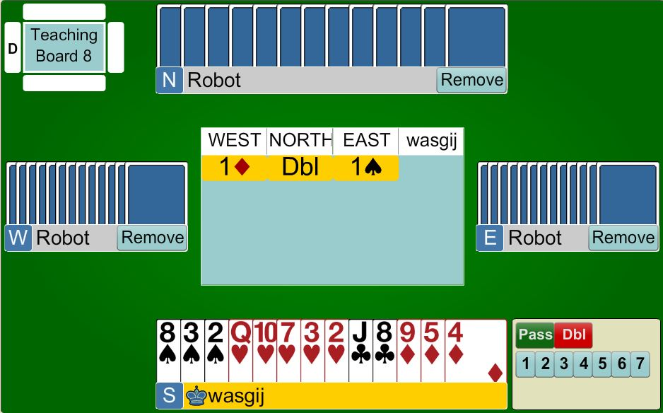
Response to the Takeout Double
PARTNER
PASS
You do not have to bid
HIM
HER
YOU

Slide 27
BEGINNERS’ LESSONS
any questions please ask
Teacher: your name
Telephone: your number
Email: your email

