Slide 1

BEGINNERS’ LESSONS
Welcome
Teacher: Your Name Here
Telephone: 123 4567
Email: email@address.co.nz

Slide 2
Tip
Play of the Hand
Trump Contracts – Drawing Trumps

Slide 3
Play of the Hand – Trump Contracts
Count how many trumps the opponents have
Draw trumps first
Remember to count how many trumps are left out
STOP drawing trumps when:
  Only the highest trump is left OR
  Your Opponents trumps have run out

Slide 4
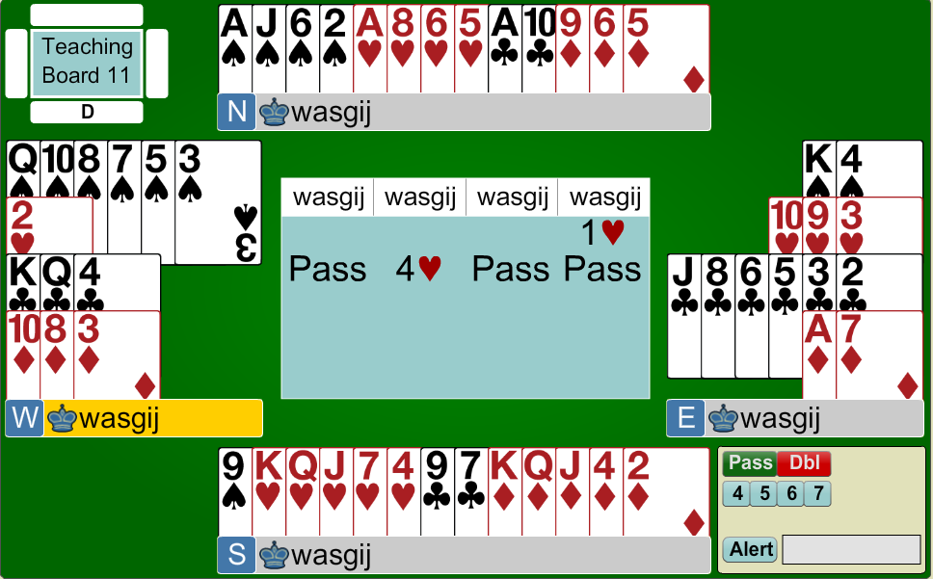

West North East South

Slide 5


1. Contract = 4♥, Lead = ♣K
We have only 1 club loser and 1 diamond loser – our contract is guaranteed
If you can guarantee your contract, draw trumps

Slide 6
Contract = 4♥, Lead = ♣K
Draw trumps until there are none left. Make sure you count them.
If you can guarantee your contract, draw trumps

Slide 7


2. Contract = 4♠, Lead = ♣Q
You have 4 losers … one spade, one club and two diamonds
If you can guarantee your contract, draw trumps

Slide 8
Contract = 4♠, Lead = ♣Q
You can get rid of a loser by discarding it on the ♥Q … BUT you must draw trumps first
If you can guarantee your contract, draw trumps

Slide 9
Contract = 4♠, Lead = ♣Q
Draw out the trumps until they are all gone (you will lose to the ♠A at some stage)
If you can guarantee your contract, draw trumps

Slide 10
BEGINNERS’ LESSONS
Please contact me if you have any questions
Teacher: Your Name Here
Telephone: 123 4567
Email: email@address.co.nz

